Slide 1
Spark Streaming
By: Yafet A.Habtemichael
610505

Slide 2
outline
Introduction
Tools I used
Installed Kafka, Activated Twitter Account
Kafka as stream-processing software platform
Spark SQL

Slide 3
As we know the spark Ecosystem is consists of 4 modules. i.e the spark sql Spark streaming Mlib (machine learning) and graph.
Spark streaming is a scalable , fault tolerant stream processing module for live data streams.
Also used for real-time predictions and recommendations.
It takes a location from your device, sending it and performing analysis on it and sending you some notification. e.g. an advertisement.

Slide 4
Data injection can be done from any sources like Kafka using complex or simple algorithms that are expressed with high level functions like map reduce joins and simple filtering can be applied.
Finally, the processed data can be pushed out to filesystems database and live dashboards.
So, the spark streaming can be used here that the users can run their code over a small piece of incoming stream of data in a scale.

Slide 5
Those data streams are divided in to DSTREAMS which internally is a sequence of RDDs.
The RDDs are then processed using Spark APIs and the results are returned in batches.
I have used Kafka to inject data in to spark streaming and I chose Hive to store the data.

Slide 6
Introduction
Twitter
Twitter is a 'microblogging' system that allows you to send and receive short posts called tweets. Tweets can be up to 140 characters long and can include links to relevant websites and resources.
To tweet your celebrations, grievances, and follow what is happening elsewhere
following, being followed, tweet, retweet, # tags create social interaction.
therefore, it is interesting to analyze it.
to Create end to end pipeline that will consume tweets from twitter API save it temporarily or permanently on HDFS and to visualize it using visualization tools.

Slide 7
Tools I used
Twitter API (source)
kafka (stream-processing)
spark streaming
spark SQL
HIVE

Slide 8
Kafka as stream-processing software platform
Kafka is designed to allow your apps to process records as they occur. Kafka is fast and uses IO efficiently by batching and compressing records. Kafka is used for decoupling data streams. Kafka is used to stream data into data lakes, applications, and real-time stream analytics systems.
It is designed to be high performance, highly available, and redundant. Examples of applications that can use such a platform include:
TVs, refrigerators, washing machines, dryers, thermostats, and personal health monitors can all send telemetry data back to a server through the Internet and Social medias like facebook, twitter, etc…

Slide 9
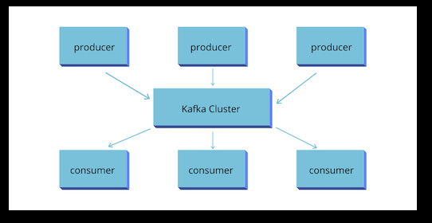
Kafka as stream-processing software platform
Topics
A topic allows easy matching between publishers and subscribers.

Slide 10
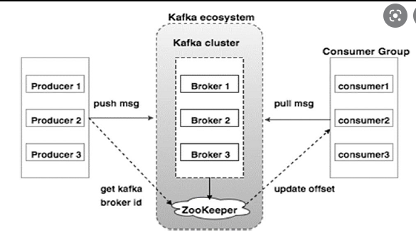
Kafka as stream-processing software platform
Brokers
Each host in the Kafka cluster runs a server called a broker that stores messages sent to the topics and serves consumer requests.
Kafka brokers all talk to Zookeeper for distributed coordination

Slide 11
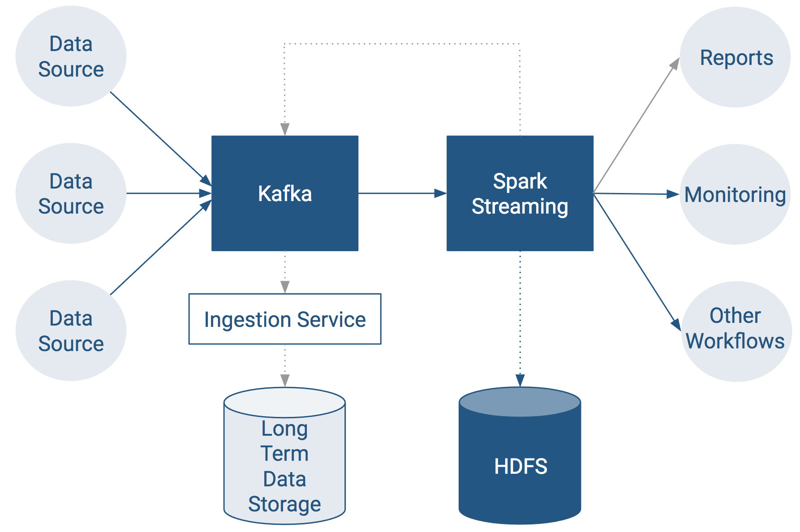
Kafka as stream-processing software platform
For real-time stream computation, Apache Spark is the tool of choice.
End-to-End Data Streaming Pipeline

Slide 12
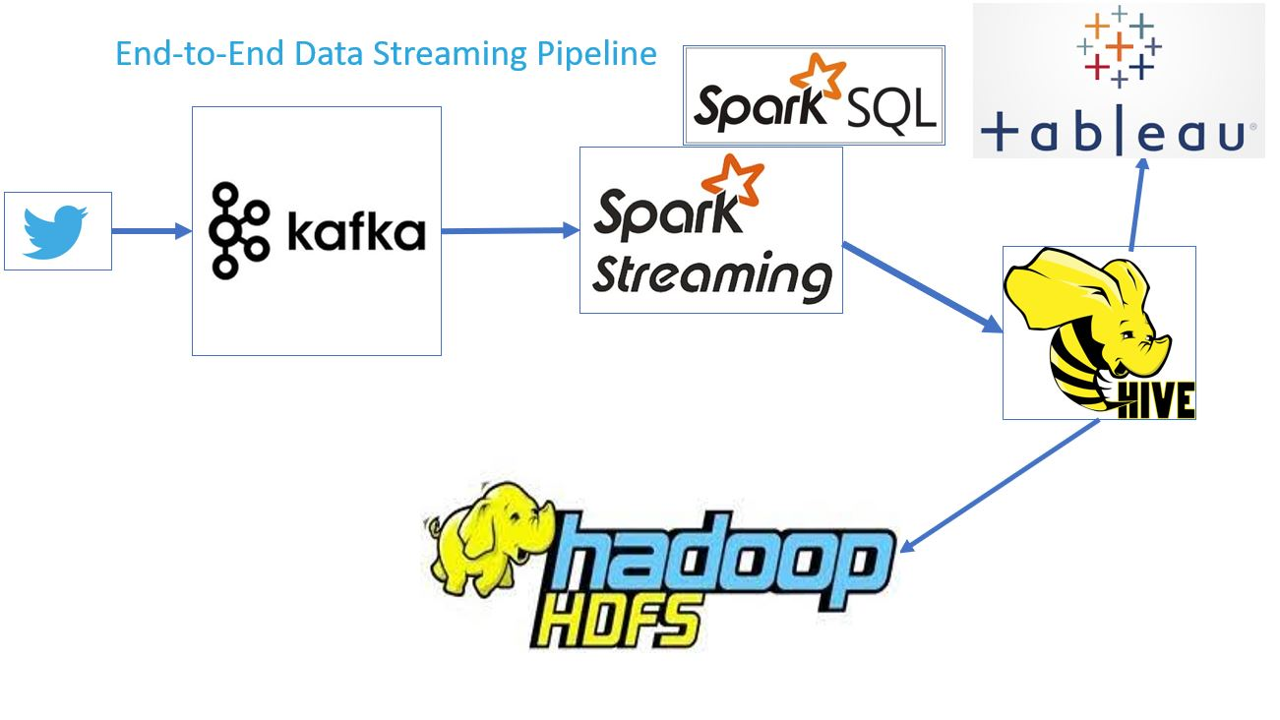

Slide 13

Spark SQL
Spark SQL :
It is Spark module for structured data processing
It provides programming abstraction called Data frames.
It integrates relational data processing with the functional programming API of Spark.
We can run queries either from terminal using spark-shell or from Eclipse or other IDEs.

Slide 14


